Slide 1


Missing Pieces
Jessica Lee

Slide 2


Components
Distance sensor
Get player
position
Javascript
Tramontana App
Player control
events
Current missing piece

Slide 3
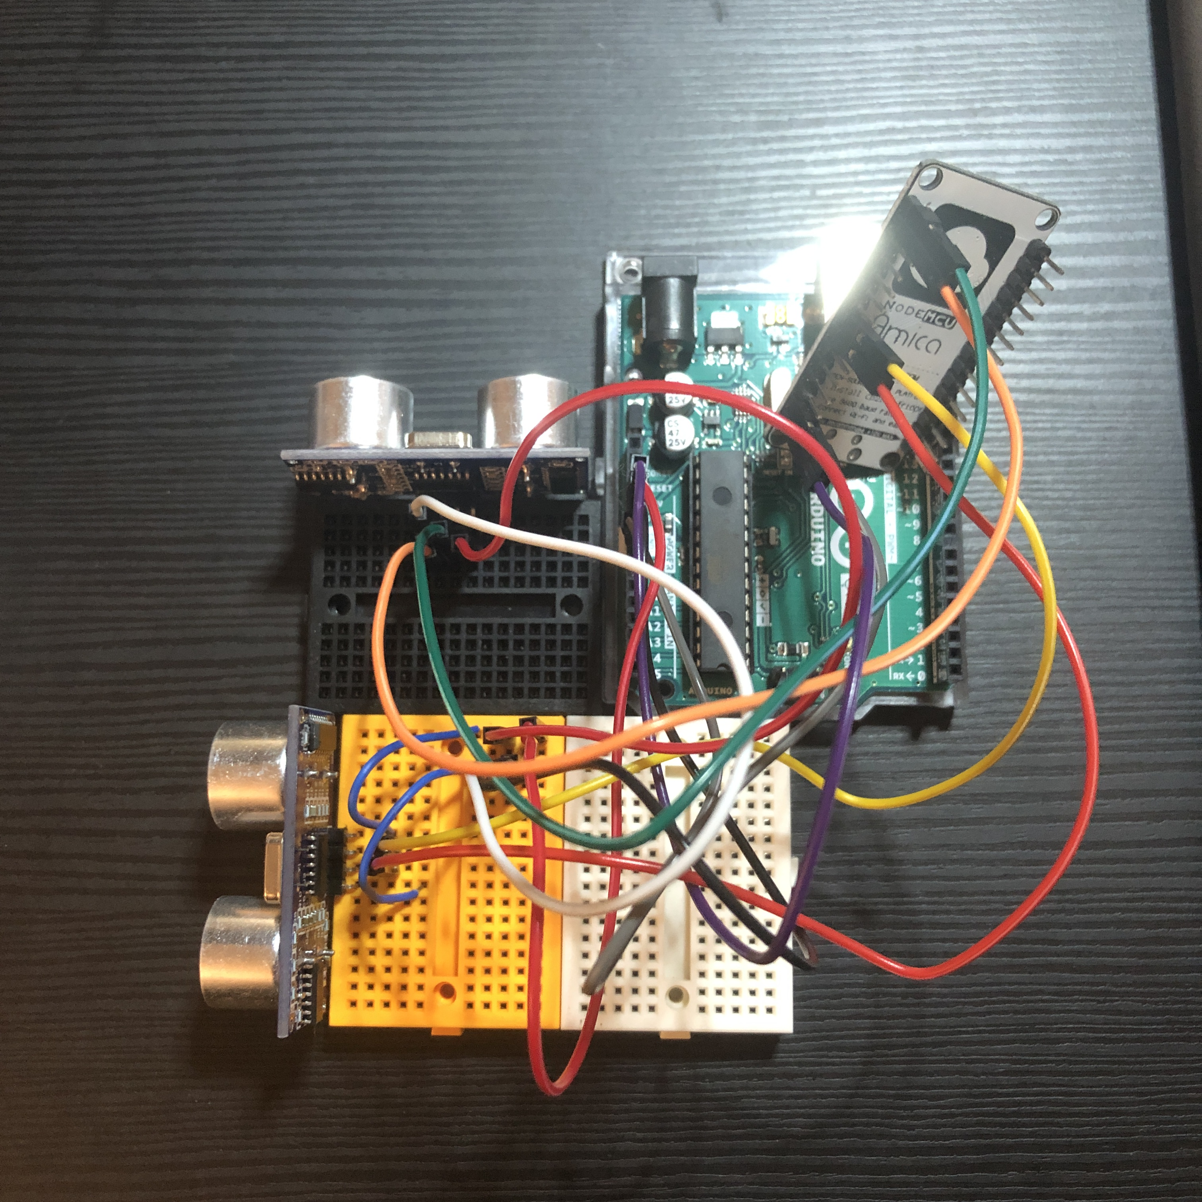
Distance Sensor
Arduino WiFi Shield
2 Ultra-sonic Sensors
Ranging distance : 2cm – 500 cm
Bread Board
Jumper Wires

Slide 4
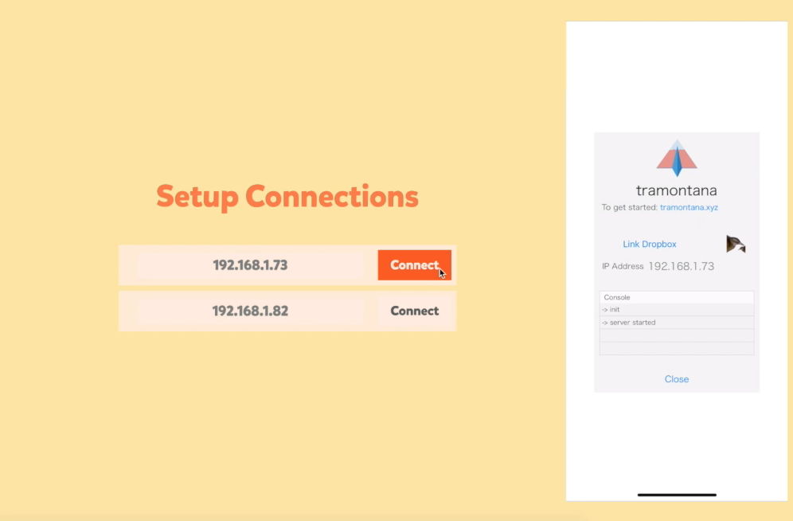
Program Flow
Set up connections
Connect the application to the phone and the sensor
Tramontana App

Slide 5
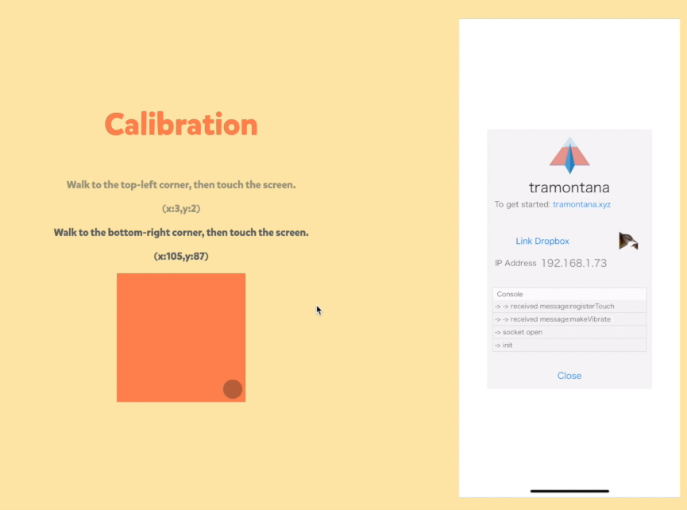
Program Flow
Position mapping
Get the sensor values at the top-left corner & the bottom-right corner in the space.

Slide 6
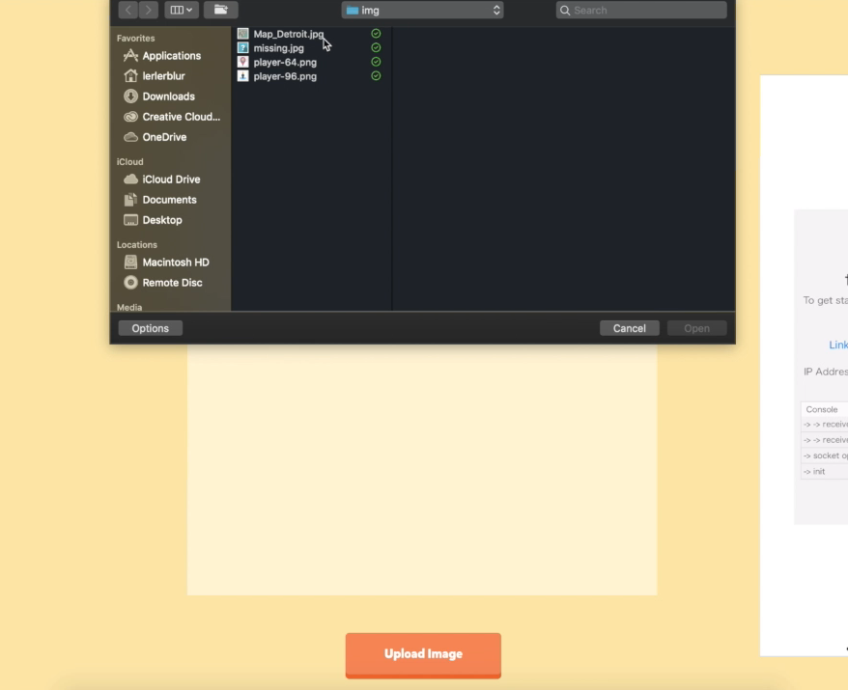
Program Flow
Upload image
Generate picture pieces from the image

Slide 7
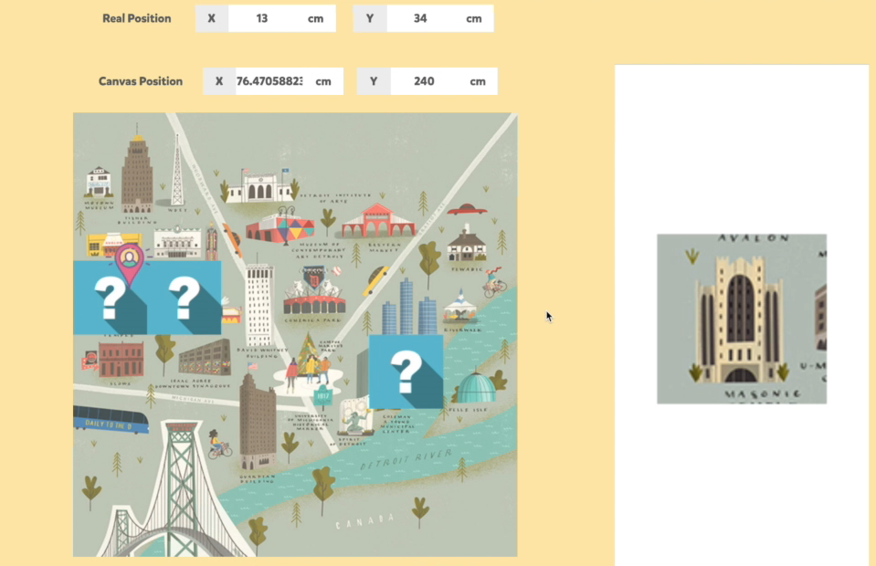
Program Flow
Begin game loop
Update player position
Draw picture pieces
TouchHandler

Slide 8

Demo

